Slide 1
MAC Functions Message Authentication Code

Slide 2
MAC Functions
Cryptographic Checksum
Used for Authentication and Integrity
They don’t provide protection again non-repudiation
Faster than Digital Signatures because they work either on block ciphers or Hash Functions.

Slide 3
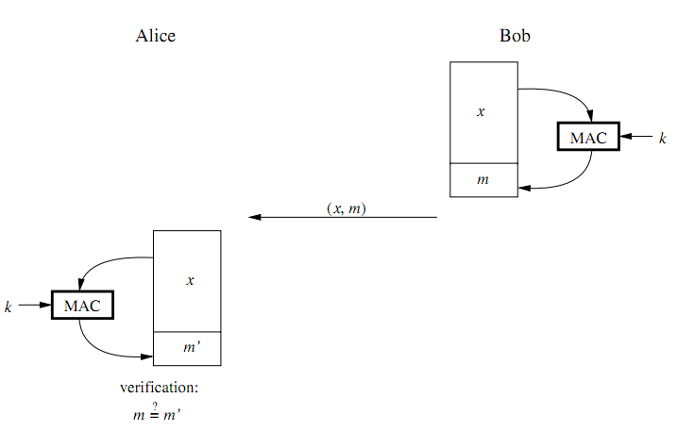
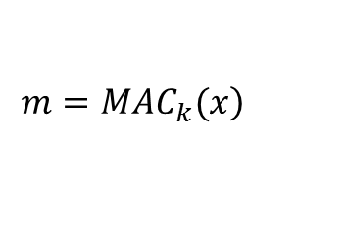
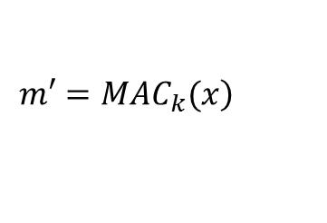
MAC Functions
MACs and digital signatures is that MACs use a symmetric key k for both generating the authentication tag and verifying it. A MAC is a function of the
symmetric key k and the message x.
$$\left.{m=MAC}_{k}(x\right)$$
$$\left.{m′=MAC}_{k}(x\right)$$
If an adversary, Oscar, changes the message during transmission, he cannot simply compute a valid MAC since he lacks the secret key.

Slide 4
Properties of MAC Functions
Cryptographic checksum. A MAC generates a cryptographically secure authentication tag for a given message.
Symmetric MACs are based on secret symmetric keys. The signing and verifying parties must share a secret key.
Arbitrary message size MACs accept messages of arbitrary length.
Fixed output length MACs generate ﬁxed-size authentication tags.
Message integrity MACs provide message integrity: Any manipulations of a message during transit will be detected by the receiver.
Message authentication The receiving party is assured of the origin of the message.
No nonrepudiation Since MACs are based on symmetric principles, they do not provide nonrepudiation.

Slide 5

MAC from HASH Function
Basic Idea: ${m=MAC}_{k}\left(x\right)=h(k,x)$
How exactly do we mix $k,x$
$m=h(k || x)$ → Secret Prefix
$m=h(x || k)$ → Secret Suffix
Both approaches are weak and should not be used.

Slide 6
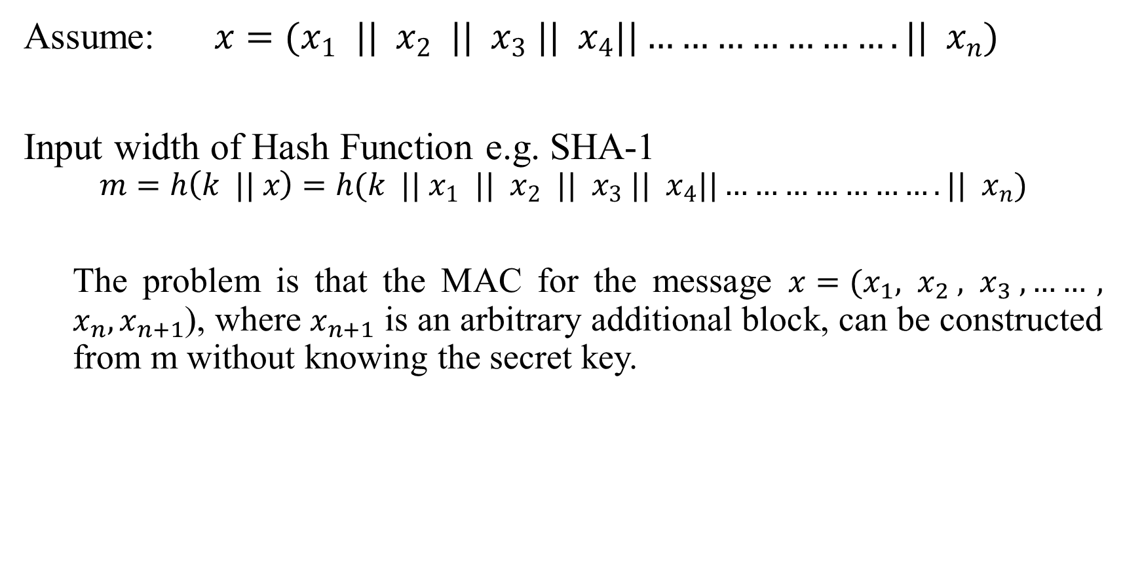
Secret Prefix MACs
Assume: $x=(x_{1} || x_{2} || x_{3} || x_{4}||………………….|| x_{n})$
Input width of Hash Function e.g. SHA-1
$$m=h\left(k || x\right)=h(k || x_{1} || x_{2} || x_{3} || x_{4}||………………….|| x_{n})$$
The problem is that the MAC for the message ${x=(x}_{1}, x_{2} , x_{3} ,……, x_{n},x_{n+1}$), where $x_{n+1}$ is an arbitrary additional block, can be constructed from m without knowing the secret key.

Slide 7
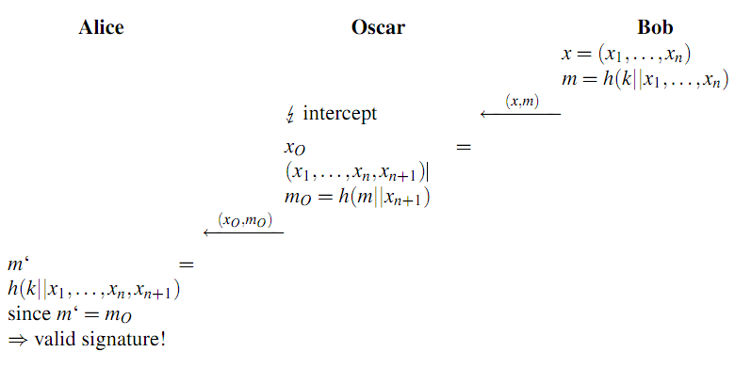
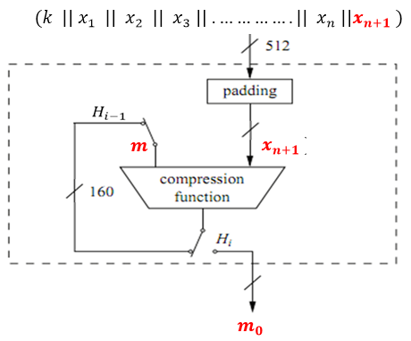
Attack against Secret Prefix MACs

Slide 8
Attack against Secret Prefix MACs

Slide 9
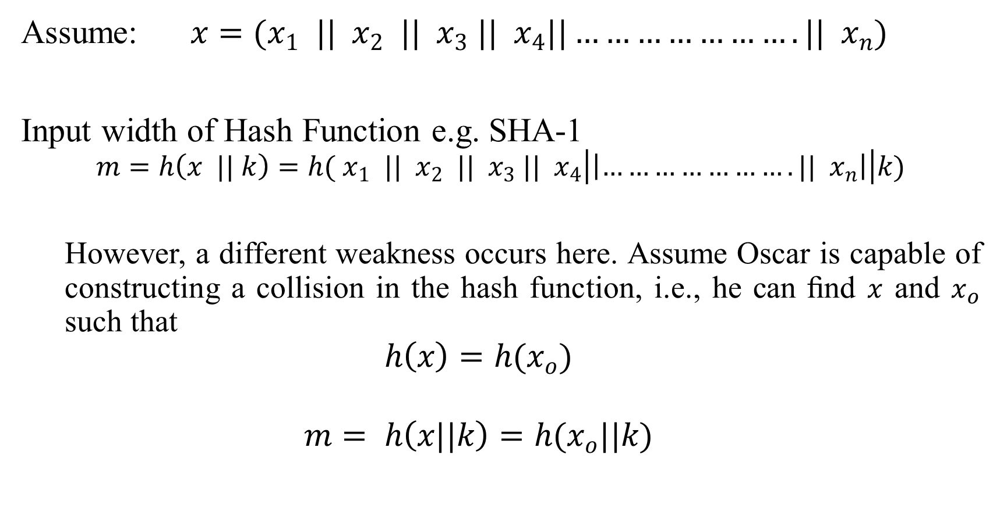
Secret Suffix MACs
Assume: $x=(x_{1} || x_{2} || x_{3} || x_{4}||………………….|| x_{n})$
Input width of Hash Function e.g. SHA-1
$$m=h\left(x || k\right)=h( x_{1} || x_{2} || x_{3} || x_{4}\left|\left|………………….|| { x}_{n}\right|\right|k)$$
However, a different weakness occurs here. Assume Oscar is capable of constructing a collision in the hash function, i.e., he can ﬁnd $x$ and $x_{o}$ such that
$$h\left(x\right)=h(x_{o})$$
$$m= h\left(x||k\right)=h(x_{o}||k)$$

Slide 10

H-MAC
Proposed in 1996
Widely used in web-browsers
SSL/TLS -> the lock on your web-browser.

Slide 11

H-MAC
IDEA: Use 2-nested secret prefix MACs
Assume: $m=h(k||\left(h\left(k \right|| x)\right)$
$${HMAC}_{k}\left(x\right)=h[(k^{+} ⊕ opad)|| h[(k^{+} ⊕ ipad)||x)]$$

Slide 12
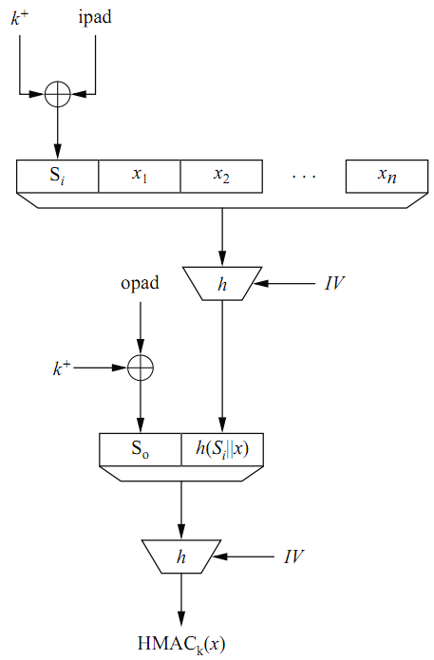

H-MAC
$${HMAC}_{k}\left(x\right)=h[(k^{+} ⊕ opad)|| h[(k^{+} ⊕ ipad)||x]$$
ipad = 00110110,00110110,……….
opad = 01011100,01011100,……

Slide 13
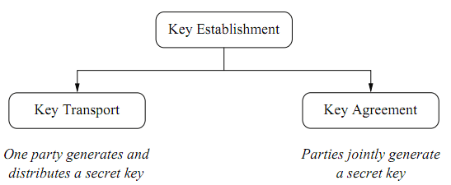
Key Establishment
If both parties are involved in key generation is will be harder to weak keys

Slide 14
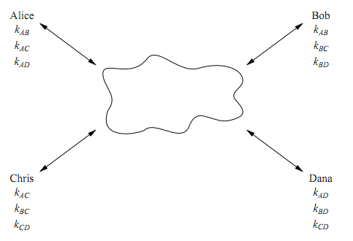
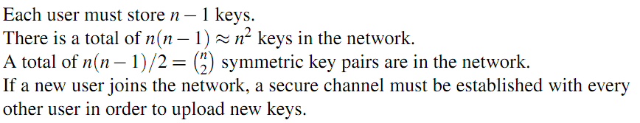
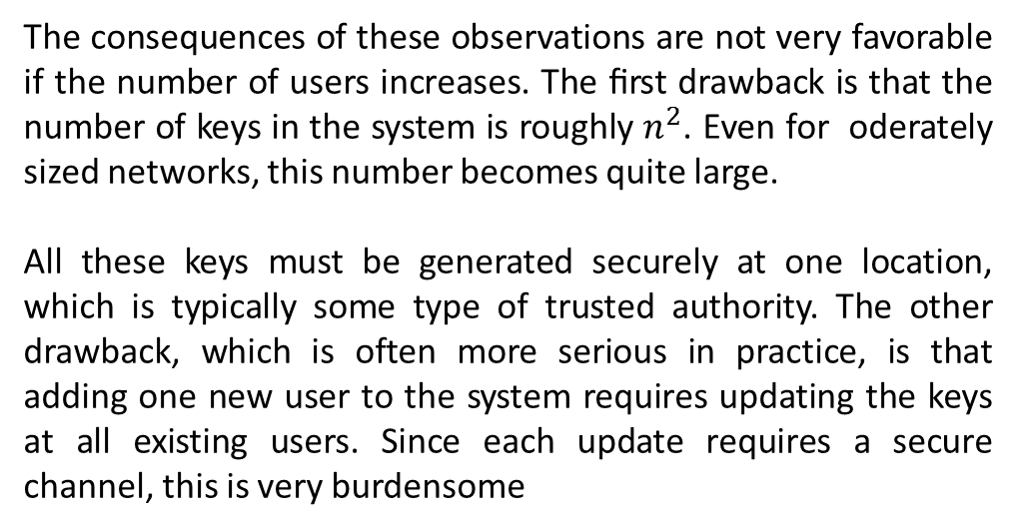
Key Distribution
The consequences of these observations are not very favorable if the number of users increases. The ﬁrst drawback is that the number of keys in the system is roughly $n^{2}$. Even for oderately sized networks, this number becomes quite large.
All these keys must be generated securely at one location, which is typically some type of trusted authority. The other drawback, which is often more serious in practice, is that adding one new user to the system requires updating the keys at all existing users. Since each update requires a secure channel, this is very burdensome

Slide 15
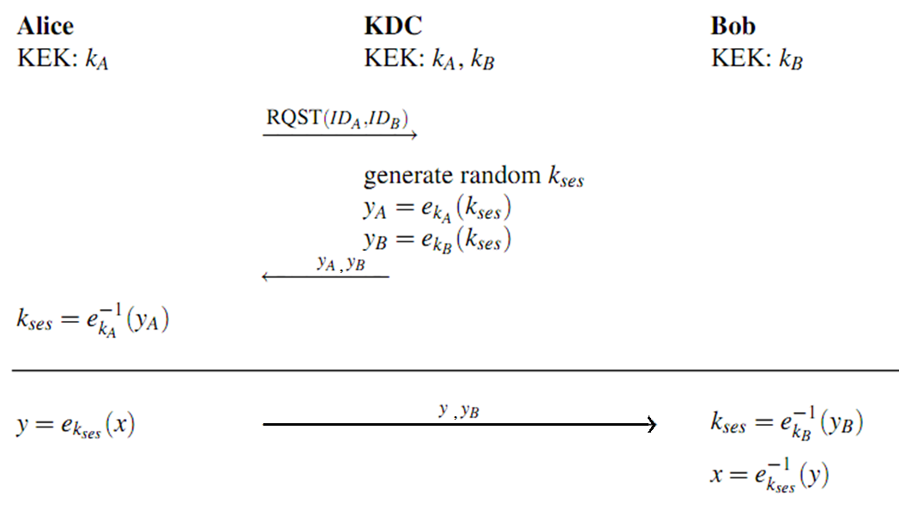
Key Distribution

